Slide 1
Revature Code First Program (Spark Curriculum)
Cynthia Enciso

Slide 2
Plan for Today
Introduction
Subject Overview
Navigating the Curriculum
Evaluations/How do I tell how I am doing?
Getting Help

Slide 3
Subjects and Tools
HTML/CSS
Text Editor
Web Browser
JavaScript
Visual Studio Code
Web Browser- Google Chrome
Java
JDK
Eclipse

Slide 4
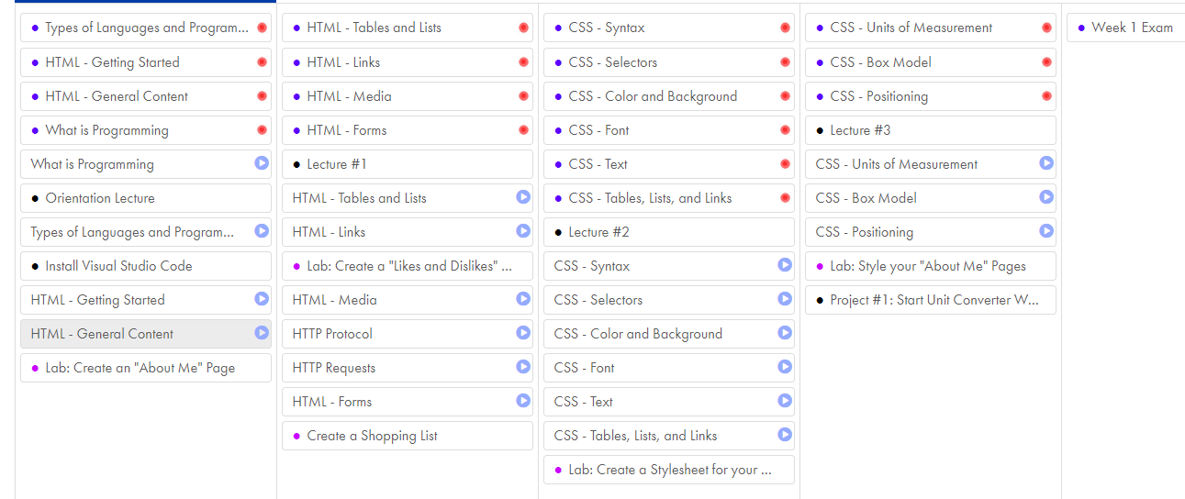
Curriculum
Quizzes
Exams
Labs
Videos
Videos
Quizzes
Exams
Labs
Projects

Slide 5
Syllabus
Late policy
Deadlines
Contact information
Exam schedules
Selection requirements

Slide 6
FAQs
Do I have to attend lecture?
Nope! But you should send me any questions you want answered beforehand.
Where/When can I find lecture recordings?
On RevaturePro, by 10 am ET the day after lecture.
When are assignments due?
By Monday morning of the next week. The weekly exam closes at 6pm ET Monday evening.
What if I fall behind?
Reach out to me as soon as things start to slip. I am here to help and on your side!
What if I don’t know how to ask my question? What if I am completely lost?
Do your absolute best to ask anyways. Include the details you can and try to explain the parts you do understand. Chances are that you know more than you realize, and I have heard the question before.
How can I reach my trainer directly?
cynthia.enciso@revature.com
DM me on slack
Is my trainer available on the weekend? What about in the evenings?
Sort of!
Those are my off hours, but I am always happy to see questions from my students at anytime of day. I just might not get back to you until typical working hours.

Slide 7
Tips For Success
Time management
Daily work / study
Get organized
Come with a can-do attitude
Done is better than perfect!
Don’t follow the rabbit-holes too deeply
Get in the developer mindset
Google is your best friend!
Utilize your support system
Don’t be afraid to ask what you consider is a “dumb” question

Slide 8
Getting Help
Discussions Board
General Questions on Assignments
Think Stack overflow
Slack
Questions during class
Coordinating study groups etc.
Email
Schedule a Tutoring Session
RevPro issues? Contact support@revature.com

Slide 9
External Resources
Can I use external resources to help me with my projects?
Yes, BUT they need to be used as references and not walkthroughs
Hangman and Text Adventure projects
There are plenty of implementations out there
I’m looking for what is in the requirements, it doesn’t matter if your implementation works
Can I collaborate with my fellow candidates?
Yes, BUT if you turn in the same project that is going too far
Bounce ideas off each other
You can share a few lines of code
I need to be able to assess your skills

